Slide 1
news facilities
Rania Atef | 01068342926 | rannia.attef@gmail.com
Naira Hassan | 01154775690 | nairahassan2308@gmail.com
Mariam Tarek | 01090709771 | mariamtarekselim@hotmail.com
Fatema Hani | 01203389851 | fatemahani19@hotmail.com
Mostafa Hesham | 01005550145 | mostafa.hesham@outlook.com

Slide 2


Slide 3
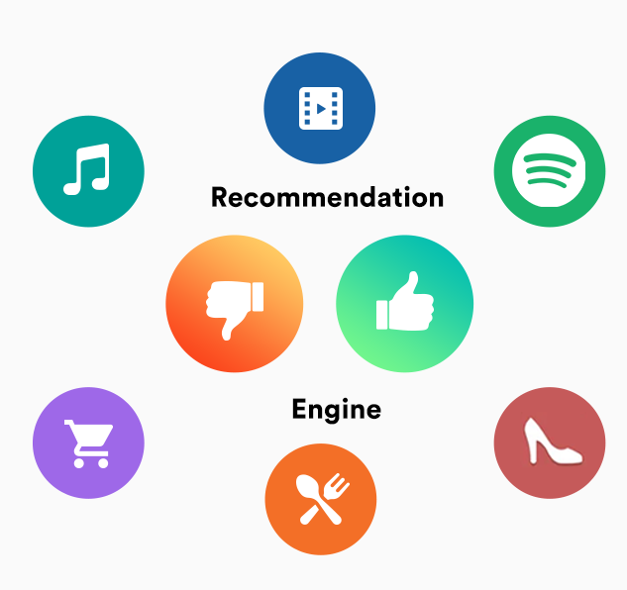
AGENDA
INTRODUCTION
PRIMARY GOALS
project Steps

Slide 4

INTRO
A recommendation system is an artificial intelligence or AI algorithm, usually associated with machine learning, that uses Big Data to suggest or recommend additional products to consumers. These can be based on various criteria, including past purchases, search history, demographic information, and other factors.

Slide 5
PRIMARY GOALS

Slide 6
Aim: With the aid of data mining, machine learning, and programming, the goal is to create a recommendation system for customers for explore the news based on what the customers search .
Problem: The news recommendation problem is the task of recommending relevant news articles to users based on their preferences and interests. The goal is to provide personalized recommendations that match the user's information needs and keep them engaged with the platform.
Solution: The ultimate goal of news recommendation systems is to improve the user experience by providing relevant and timely news articles that match the user's interests and preferences.
Application: Website that recommend news based on customer search.

Slide 7
project Steps:
1- Web Scraping.
2- Data Preparation & ETL.
3- Pre-processing
4- Text Classification.
5- Recommendation
6- Summarization
7- Deployment

Slide 8
Web scraping

Slide 9
Beautiful soap
Web scraping is the process of gathering information from the Internet. Even copying and pasting the lyrics of your favourite song is a form of web scraping! However, the words “web scraping” usually refer to a process that involves automation.
Beautiful Soup is a Python library for pulling data out of HTML and XML files. It works with your favourite parser to provide idiomatic ways of navigating, searching, and modifying the parse tree. It commonly saves programmers hours or days of work.

Slide 10
ETL

Slide 11
Handling data
Data handling
Remove nulls & duplicates
Concatenate all categories
Translation

Slide 12
translation
Googletrans is a free and unlimited python library that implemented Google Translate API. This uses the Google Translate Ajax API to make calls to such methods as detect and translate.

Slide 13
pre-processing

Slide 14
pre-processing
Natural Language Processing (NLP) is a branch of Data Science which deals with Text data. Apart from numerical data, Text data is available to a great extent which is used to analyze and solve business problems. But before using the data for analysis or prediction, processing the data is important.
To prepare the text data for the model building we perform text pre-processing. It is the very first step of NLP projects. Some of the pre-processing steps are:
Removing punctuations like . , ! $( ) * % @
Removing Stop words
Remove numerical digits
Lemmatization

Slide 15
Text Classification

Slide 16
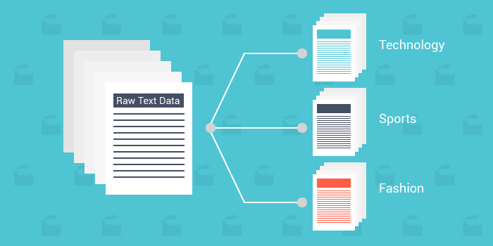

Slide 17
Text classification
Text classification also known as text tagging or text categorization is the process of categorizing text into organized groups. By using Natural Language Processing (NLP), text classifiers can automatically analyze text and then assign a set of pre-defined tags or categories based on its content.
Steps we follow to classify text:
1- doc2vec by Gensim
2- random forest with doc2vec, accuracy 82%
3- xgboost with Tf-idf , accuracy 98%
3- After facing some issues Tf-idf Vectorizer & Xgboost, get accuracy 94%

Slide 18
Recommendation

Slide 19
Recommendation algorithm
1- TF-IDF stands for Term Frequency Inverse Document Frequency of records. It can be defined as the calculation of how relevant a word in a series or corpus is to a text. The meaning increases proportionally to the number of times in the text a word appears but is compensated by the word frequency in the corpus (data-set).
2- Cosine similarity measures the similarity between two vectors of an inner product space. It is measured by the cosine of the angle between two vectors and determines whether two vectors are pointing in roughly the same direction. It is often used to measure document similarity in text analysis.

Slide 20
LDA – Topic modelling

Slide 21
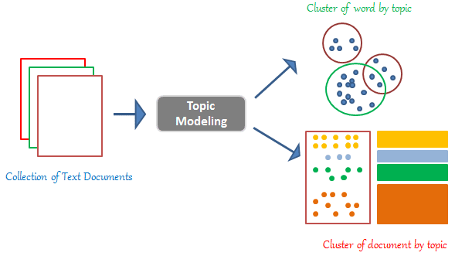
LDA
A tool and technique for Topic Modelling, Latent Dirichlet Allocation (LDA) classifies or categorizes the text into a document and the words per topic, these are modelled based on the Dirichlet distributions and processes.

Slide 22
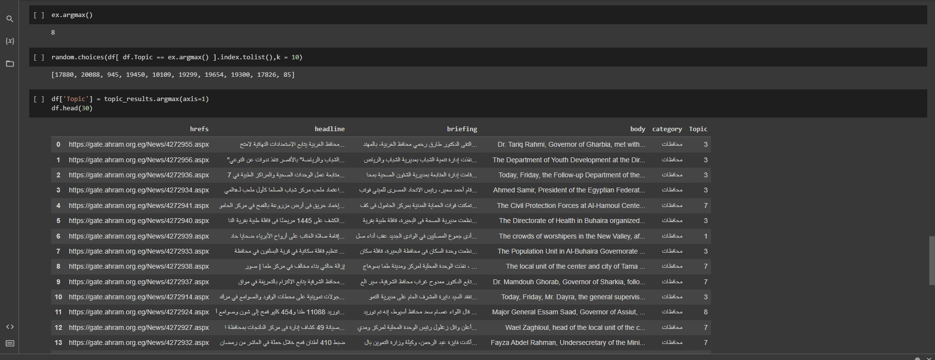
LDA

Slide 23
summarization

Slide 24
Summarization
Summarization creates a shorter version of a document or an article that captures all the important information. Along with translation, it is another example of a task that can be formulated as a sequence-to-sequence task. Summarization can be:
Extractive: extract the most relevant information from a document.
Abstractive: generate new text that captures the most relevant information.

Slide 25
Summarization
Abstractive Methods
Transformers models like: Bert.
Reinforcment learning like: seqGAN

Slide 26
Summarization
Abstractive: generate new text that captures the most relevant information.
Arabic Tf5 Large model:
A customized T5 Model for Arabic and English Task. It could be used as an alternative for google/mt5-large model, as it's much smaller and only targets Arabic and English based tasks.
https://huggingface.co/marefa-nlp/summarization-arabic-english-news

Slide 27
deployment

Slide 28
streamlit
Streamlit is an open-source Python library that makes it easy to create and share beautiful, custom web apps for machine learning and data science projects. In just a few minutes you can build and deploy powerful apps.

Slide 29
THANK YOU

